Slide 1
C#

Slide 2
What is C#?
It is an object-oriented programming language created by Microsoft that runs on the .NET Framework.
C# has roots from the C family, and the language is close to other popular languages like C++ and Java.
C# is used for:
Mobile applications
Desktop applications
Web applications
Web services
Web sites
Games
VR
Database applications
And much, much more!

Slide 3
Why Use C#?
It is one of the most popular programming language in the world
It is easy to learn and simple to use
It has a huge community support
C# is an object-oriented language which gives a clear structure to programs and allows code to be reused, lowering development costs
As C# is close to C, C++ and Java, it makes it easy for programmers to switch to C# or vice versa

Slide 4
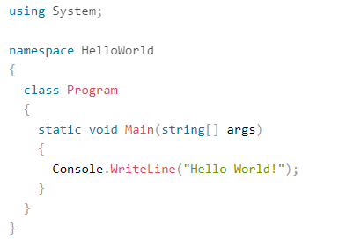
C# Syntax
Code to print "Hello World" to the screen

Slide 5



C# Output
To output values or print text in C#, you can use the WriteLine() method:
You can add as many WriteLine() methods as you want. Note that it will add a new line for each method:
You can also output numbers, and perform mathematical calculations:

Slide 6

The Write Method
There is also a Write() method, which is similar to WriteLine().
The only difference is that it does not insert a new line at the end of the output:

Slide 7

C# Comments
Comments can be used to explain C# code, and to make it more readable. It can also be used to prevent execution when testing alternative code.
Single-line Comments
Single-line comments start with two forward slashes (//).
Any text between // and the end of the line is ignored by C# (will not be executed).

Slide 8

C# Comments
Multi-line comments start with /* and ends with */.
Any text between /* and */ will be ignored by C#.

Slide 9
C# Variables
Variables are containers for storing data values.
In C#, there are different types of variables (defined with different keywords), for example:
int - stores integers (whole numbers), without decimals, such as 123 or -123
double - stores floating point numbers, with decimals, such as 19.99 or -19.99
char - stores single characters, such as 'a' or 'B'. Char values are surrounded by single quotes
string - stores text, such as "Hello World". String values are surrounded by double quotes
bool - stores values with two states: true or false

Slide 10


C# Variables
Declaring (Creating) Variables
To create a variable, you must specify the type and assign it a value:
Where type is a C# type (such as int or string), and variableName is the name of the variable (such as x or name). The equal sign is used to assign values to the variable.
To create a variable that should store text, look at the following example:

Slide 11

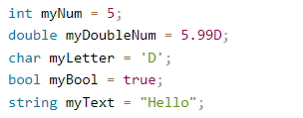
C# Variables

Slide 12

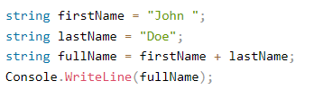
Display Variables
The WriteLine() method is often used to display variable values to the console window.
To combine both text and a variable, use the + character:

Slide 13

Display Variables
For numeric values, the + character works as a mathematical operator (notice that we use int (integer) variables here):

Slide 14


Declare Many Variables
To declare more than one variable of the same type, use a comma-separated list:
You can also assign the same value to multiple variables in one line:

Slide 15
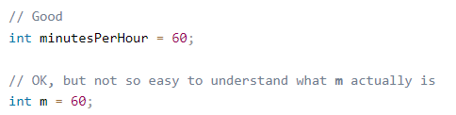
Identifiers
All C# variables must be identified with unique names.
These unique names are called identifiers.
Identifiers can be short names (like x and y) or more descriptive names (age, sum, totalVolume).
It is recommended to use descriptive names in order to create understandable and maintainable code:

Slide 16
Variable Naming Rules
The general rules for naming variables are:
Names can contain letters, digits and the underscore character (_)
Names must begin with a letter or underscore
Names should start with a lowercase letter and it cannot contain whitespace
Names are case sensitive ("myVar" and "myvar" are different variables)
Reserved words (like C# keywords, such as int or double) cannot be used as names

